Slide 1
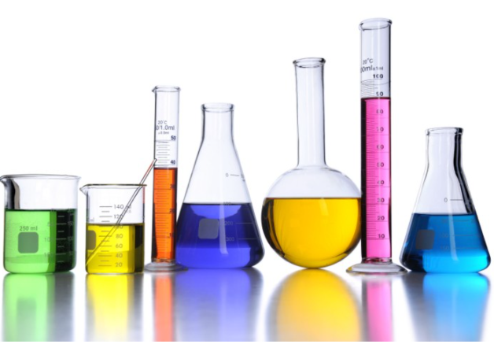
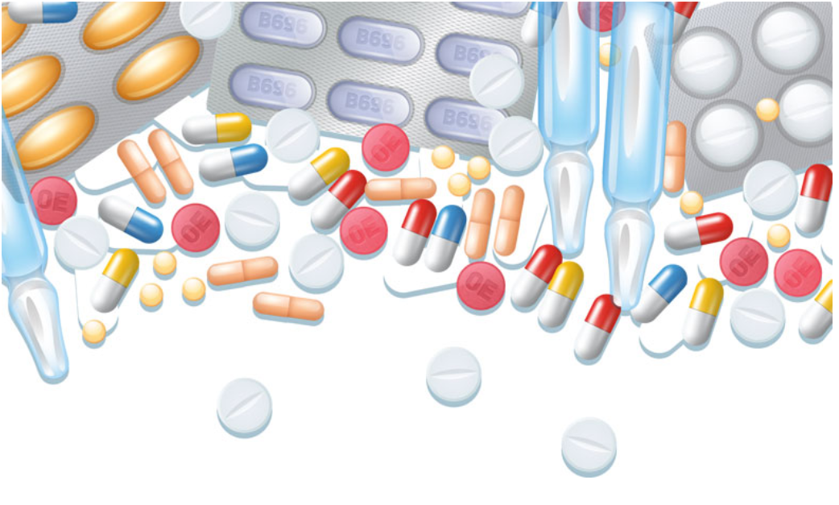
Discover the Hidden Message of UMLS NCI Ontology
Advisor: Rong Liu
Group Member: Qicheng Zhang, Ruixi Wang, Xin Zhao

Slide 2
Problem description
During the pandemic outbreak, many patients are suffering pain and loss due to the low efficiency of developing the COVID vaccine
In order to alleviate the suffering of patients, we aim to accelerate new drug discovery by applying artificial intelligence in the medical industry (e.g. node embedding and networks embedding)
We are not only able to model disease relationship based on pairwise similarities, but also identify drug and diseases phenotypic relationships
Our ultimate goal is to benefit drug innovation and development by lowering the R&D cost

Slide 3
Objectives
We generate two research objectives:
1. Find out how the similarities are connected and under what specific context
2. Minimize translational gaps between animal experiments and clinical outcomes in order to have more accurate results

Slide 4

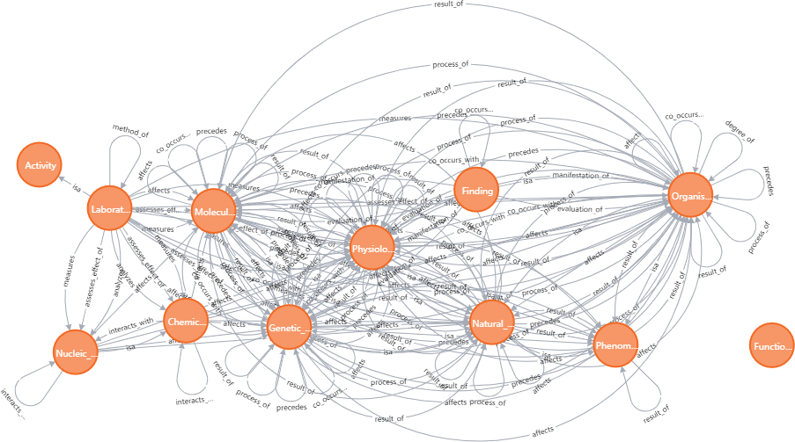
Dataset Description
We use Unified Medical Language System (UMLS) as our data sources, and we’ve been collecting entities and their relations from UMLS
With Python, we implement Neo4j, a graph database management system, to visualize the knowledge graph from UMLS

Slide 5
Dataset Description (Cont.)
By importing the file “MRHIER.RRF” from UMLS database to the Java coding, we generate 30 knowledge graphs for different ontologies
NCI Thesaurus provides definitions, synonyms, and other information on nearly 10,000 cancers and related diseases, 17,000 single agents and related substances, and other topics related to cancer and biomedical research
We discovered 312,695 hierarchical relationships in NCI knowledge graph

Slide 6
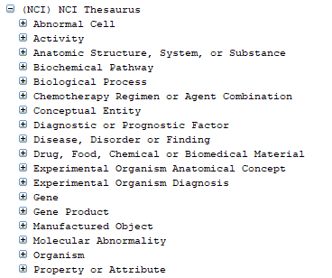
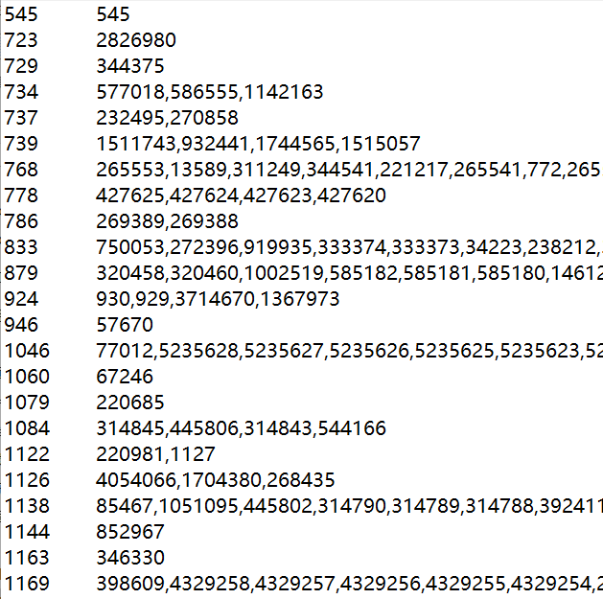
UMLS NCI Ontology
Parent CUI
List of children CUIs

Slide 7
Node2vec Node Embedding

Slide 8
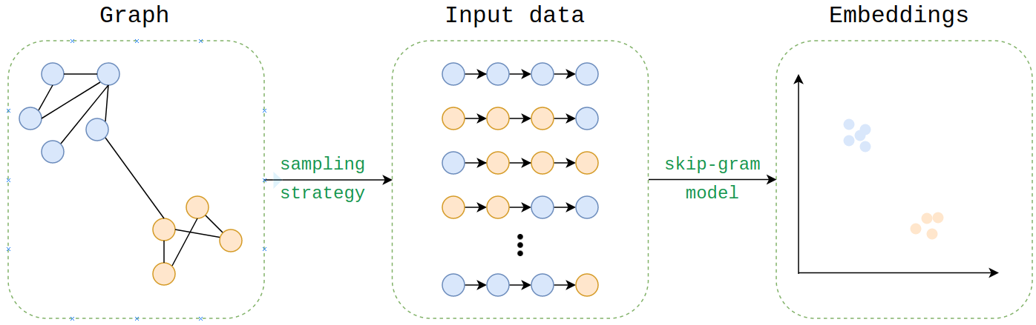
Methodology
We use node2vec neural network to embedding NCI knowledge graph

Slide 9
Approach
Random walks parameters:
p = 1
q = 1
dimensions = 128
num_walks = 4
walk_length = 10
Node2vec model parameters:
window_size = 100
epochs = 1
workers = multiprocessing.cpu_count()
9

Slide 10
Link Prediction

Slide 11
Objectives
Explore unseen relations based on our NCI dataset by three steps:
train classifiers with node embeddings;
select the best performance classifier;
evaluate the selected classifier on unseen data to validate its ability to generalize.

Slide 12
Process
Step 1 :train classifiers with node embeddings:
calculate link-edge embeddings for the positive and negative edge samples by applying a binary operator on the embeddings of the source and target nodes of each sampled edge.
train a logistic regression classifier to predict a binary value indicating whether an edge between two nodes should exist or not.

Slide 13
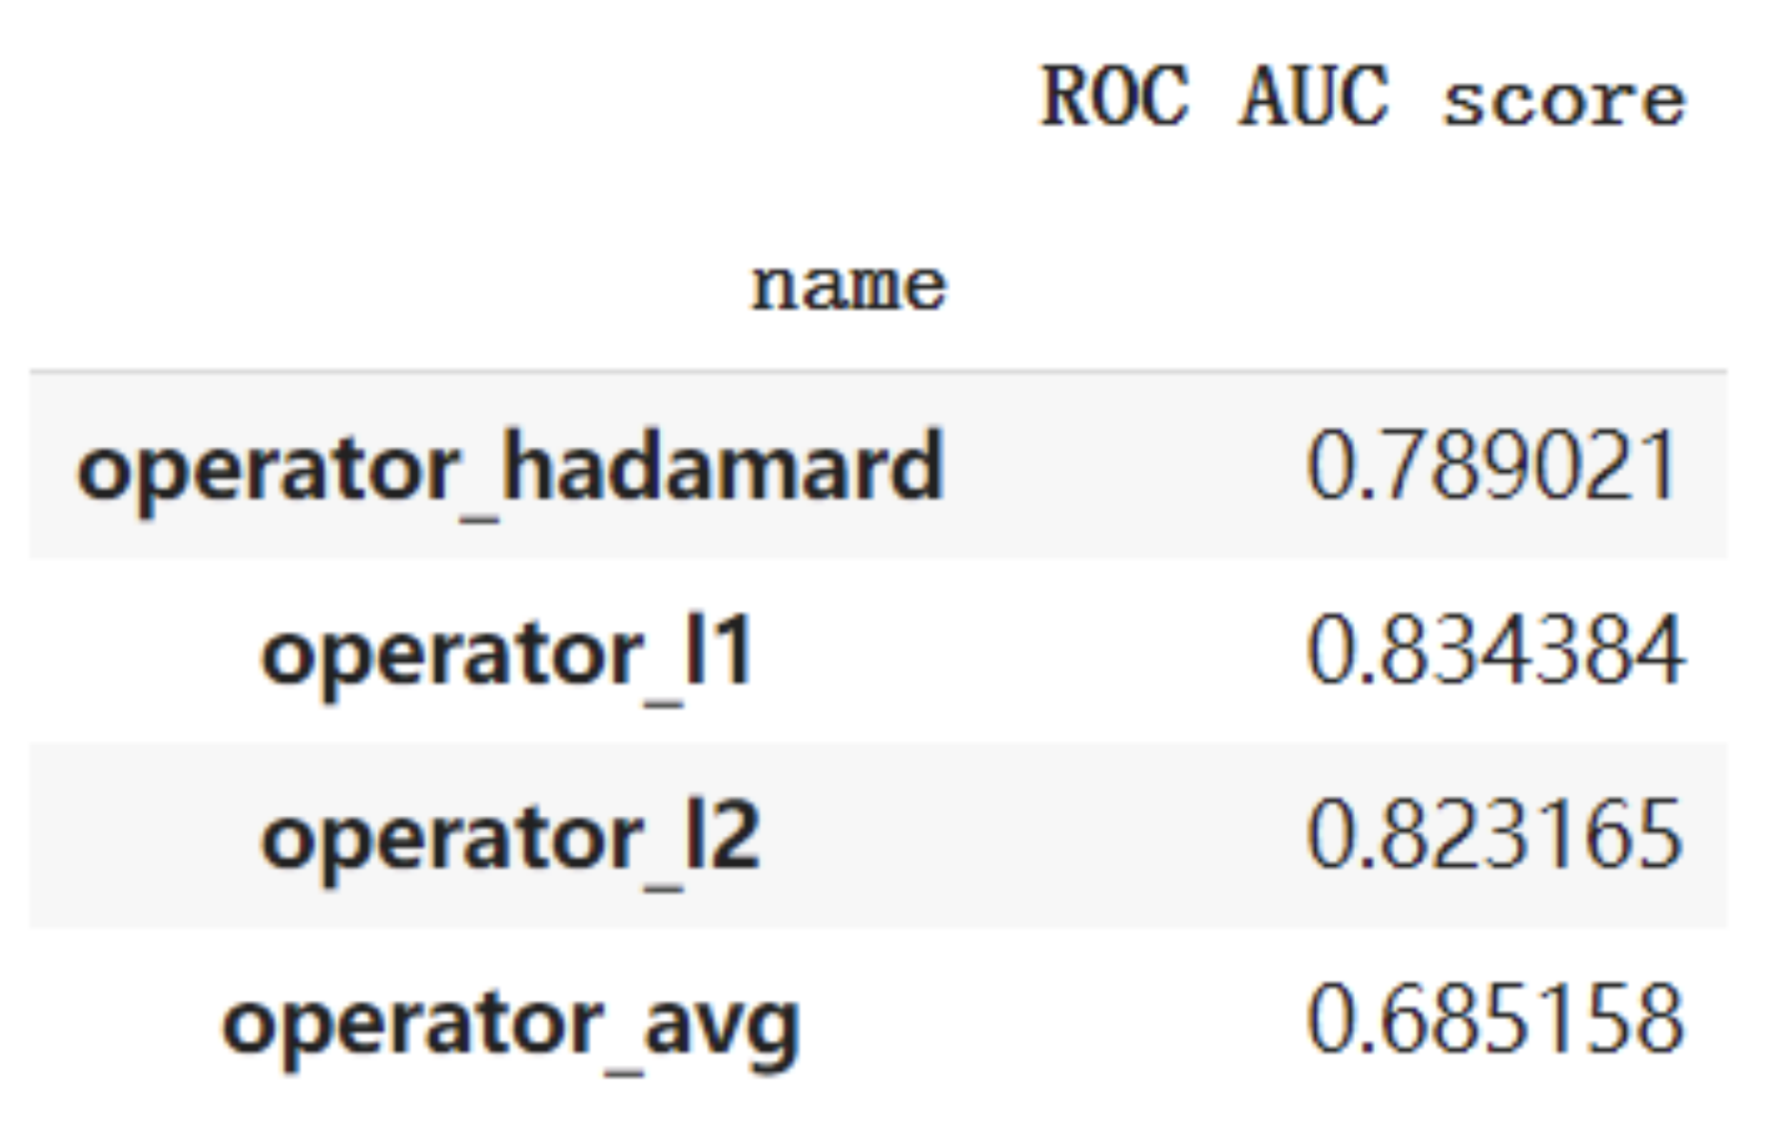
Process
Step 2 :select the best performance classifier :
Step 3:evaluate the selected classifier on unseen data :
The AUC score on test set
using L1 norm is 0.809.

Slide 14
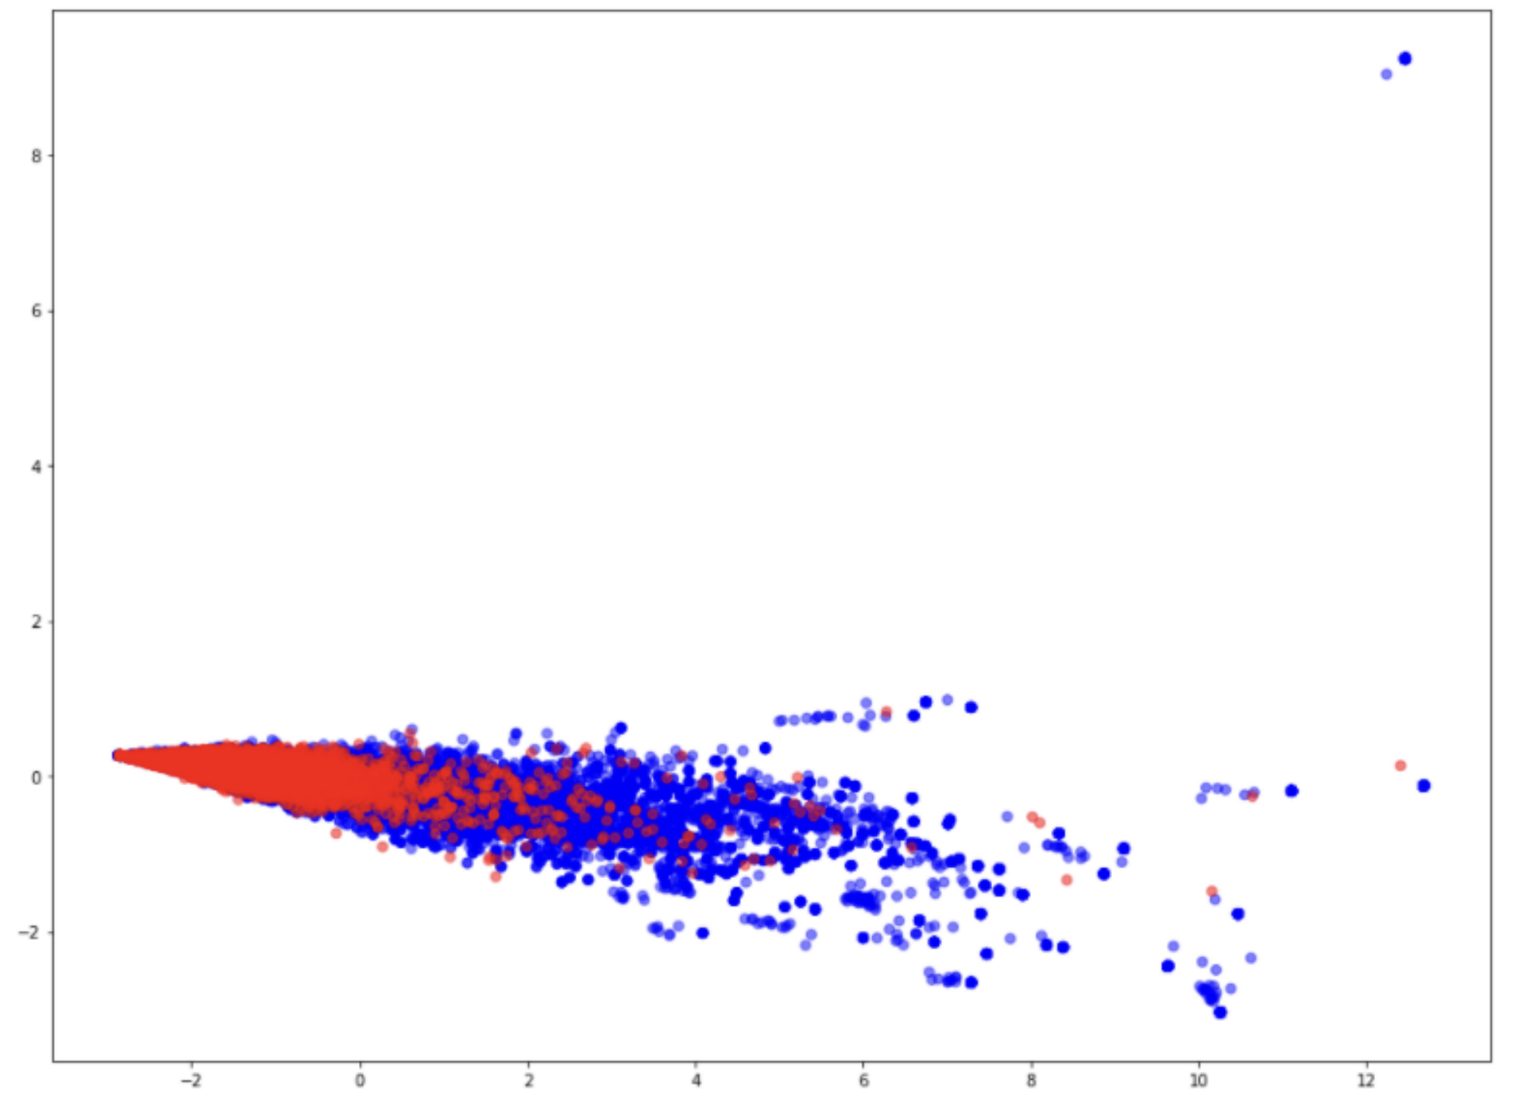
Model visualization
The blue points are positive edges, which means two nodes are connected based on our model’s prediction, the red points are negative edges, which means the edges should not exist.

Slide 15
Deep Graph CNN

Slide 16
Preparing data
We use the proteins dataset, a collection of graphs each with an attached categorical label
Each graph represents a protein and graph labels represent whether they are enzymes or non-enzymes
The dataset includes 1113 graphs with 39 nodes and 73 edges on average for each graph
Graph nodes have 4 attributes, and each graph is labelled as belonging to 1 of 2 classes

Slide 17
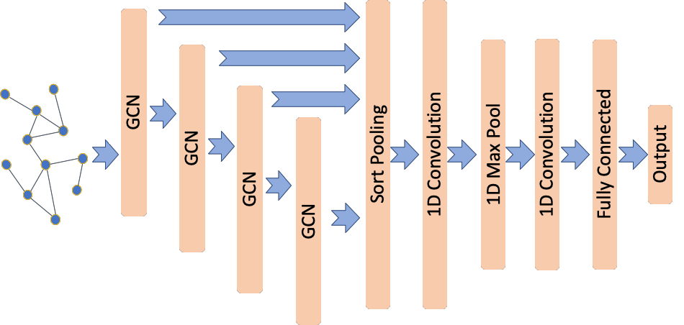
Creating the model

Slide 18
Train the model
We prepare a new suitable generator prepared for training
We train the model using the model’s fit method
We are going to use 90% of the data for training and the remaining 10% for testing
We set epochs to be 100 to complete the training faster, but the accuracy could be lower

Slide 19
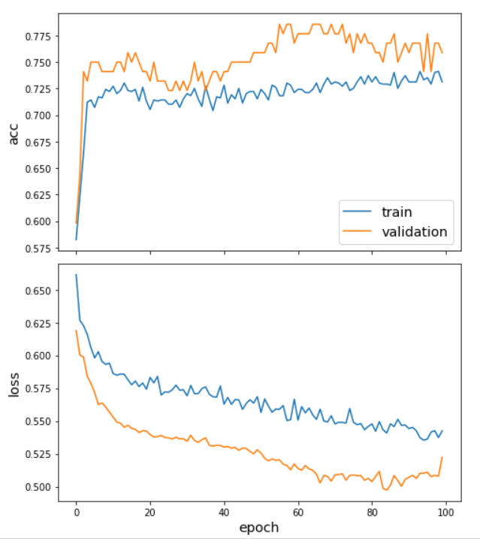

Testing

Slide 20
Conclusion
Link prediction model can predict unseen paths or edges for two random nodes, and DGCNN model can predict whether the protein is enzymes or not
With DGCNN model as a hidden path for NCI knowledge, it will faster to find the connections between drug and cancer by implementing link prediction model
By combining of link prediction model and DGCNN model, now we have made the prediction more accurate and cautious, so it is a worthwhile direction of research

Slide 21
Thank you!

